Slide 1
Module 4.4
Other issues in Access Control

Slide 2
Weakness in isolation, privileges
Similar problems to Unix
E.g., Rootkits leveraging dynamically loaded kernel modules
Windows Registry
Global hierarchical database to store data for all programs
Registry entry can be associated with a security context that limits access; common to be able to write sensitive entry
Enabled By Default
Historically, many Windows deployments also came with full permissions and functionality enabled

Slide 3
Passwords
The most common logical access control
Sometimes referred to as a logical token
A secret combination of letters and numbers that only the user knows
A password should never be written down
Must also be of a sufficient length and complexity so that an attacker cannot easily guess it (password paradox)

Slide 4
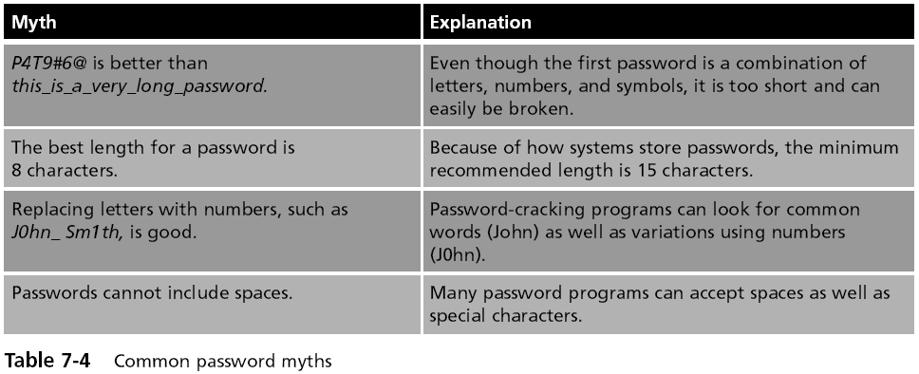
Passwords Myths

Slide 5
Attacks on Passwords
Brute force attack
Simply trying to guess a password through combining a random combination of characters
Passwords typically are stored in an encrypted form called a “hash”
Attackers try to steal the file of hashed passwords and then break the hashed passwords offline

Slide 6
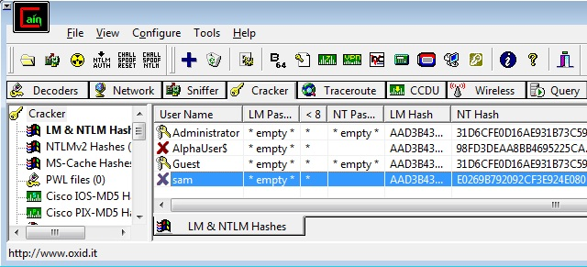
How to Get the Hashes
Easy way: Just use Cain
Cracker tab, right-click, "Add to List"

Slide 7
Attacks on Passwords
Dictionary attack
Guess passwords from a dictionary
Works if the password is a known common password
Rainbow tables
Make password attacks faster by creating a large pregenerated data set of hashes from nearly every possible password combination
Works well against Windows passwords because Microsoft doesn't use the salting technique when computing hashes

Slide 8
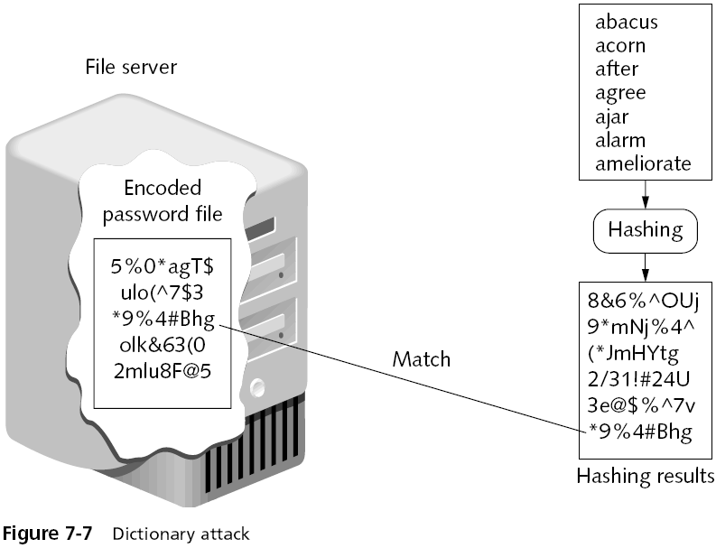

Slide 9
Rainbow Tables
Generating a rainbow table requires a significant amount of time
Rainbow table advantages
Can be used repeatedly for attacks on other passwords
Rainbow tables are much faster than dictionary attacks
The amount of time needed on the attacking machine is greatly reduced

Slide 10
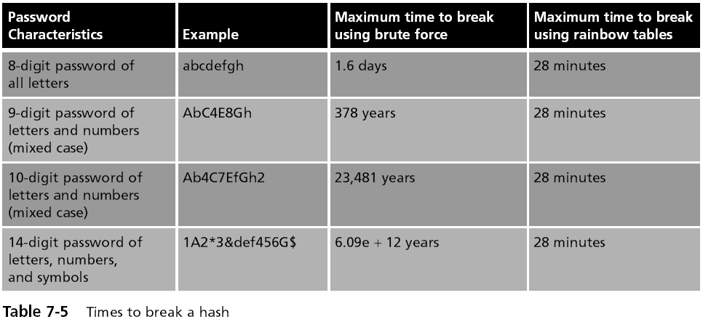
Rainbow Table Attack

Slide 11
Passwords (continued)
One reason for the success of rainbow tables is how older Microsoft Windows operating systems hash passwords
A defense against breaking encrypted passwords with rainbow tables
Hashing algorithm should include a random sequence of bits as input along with the user-created password
These random bits are known as a salt
Make brute force, dictionary, and rainbow table attacks much more difficult

Slide 12
No Salt!
To make hashing stronger, add a random "Salt" to a password before hashing it
Windows doesn't salt its hash!
Two accounts with the same password hash to the same result, even in Windows 7 Beta!
This makes it possible to speed up password cracking with precomputed Rainbow Tables

Slide 13

Demonstration
Here are two accounts on a Windows 7 Beta machine with the password 'password'
This hash is from a different Windows 7 Beta machine

Slide 14
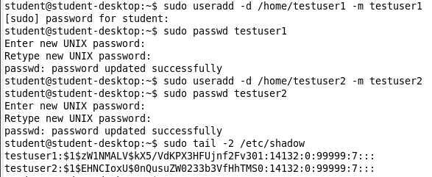
Linux Salts its Hashes

Slide 15
Password Policy
A strong password policy can provide several defenses against password attacks
The first password policy is to create and use strong passwords
One of the best defenses against rainbow tables is to prevent the attacker from capturing the password hashes
A final defense is to use another program to help keep track of passwords

Slide 16
Domain Password Policy
Setting password restrictions for a Windows domain can be accomplished through the Windows Domain password policy
There are six common domain password policy settings, called password setting objects
Used to build a domain password policy

Slide 17
